Slide 1

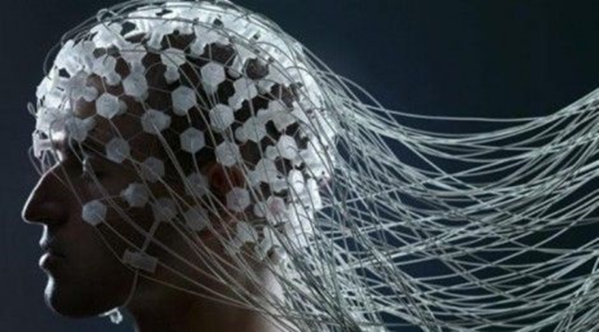
Investigation of the relation between Human’s brain object recognition and its working memory using advanced EEG signal analysis and ML techniques-Final Stage

Slide 2
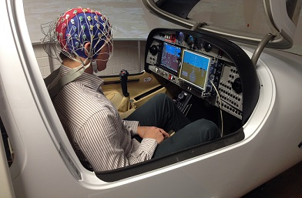
Intro
I believe that Neuroscience and Artificial Intelligence have pushed each other forward. The concept of artificial neural networks (ANNs), which is inspired by the concept of biological neural networks, has undoubtedly altered AI history. When we look at the milestones of ANNs like convolution, long-term short memory, attention, learning algorithms, and so on, we can see how bio-thoughts influenced them. For this reason, I would like to use analysis the role of brain’s different parts communications in object recognition task.
In the following I tried to propose a few questions and answers to provide the reader with a better perspective.

Slide 3
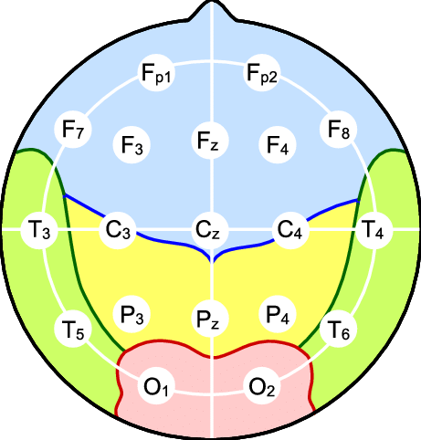
EEG and ten/20
Ten/20 coordinating system
The Ten/20 system is a measurement system that divides the human scalp into 19 sections and measures it. Each electrode of the EEG recording device will be positioned on one of these 19 locations in this arrangement. This system is in place. Pre-frontal (Fp), frontal (F), temporal (T), parietal (P), occipital (O), and central (C) are the names of the brain regions (C). The idea behind this brain partitioning is that distinct brain areas (Lobes) are important in different cognitive tasks. For example, visual processors are in the occipital lobes, working memory is in the temporal lobes, and auditory lobes are in the auditory lobe....

Slide 4
Brains different regions’ cognitive function
According to the Johns Hopkins’ neurology department.
Frontal lobe. The largest lobe of the brain, located in the front of the head, the frontal lobe is involved in personality characteristics, decision-making and movement. Recognition of smell usually involves parts of the frontal lobe. The frontal lobe contains Broca’s area, which is associated with speech ability.

Slide 5
Brains different regions’ cognitive function
Parietal lobe. The middle part of the brain, the parietal lobe helps a person identify objects and understand spatial relationships (where one’s body is compared with objects around the person). The parietal lobe is also involved in interpreting pain and touch in the body. The parietal lobe houses Wernicke’s area, which helps the brain understand spoken language.
Occipital lobe. The occipital lobe is the back part of the brain that is involved with vision.
Temporal lobe. The sides of the brain, temporal lobes are involved in short-term memory, speech, musical rhythm and some degree of smell recognition.

Slide 6
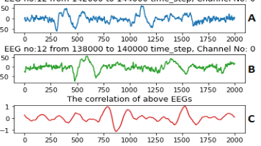

EEG data cross-correlation analysis
The cross-correlation between two EEG channels measures the level of dependency between their frequency components. More specifically, If the cross-correlation of two EEG channels is 1 at a time $t0$, the EEGs are behaving similarly. That is, the amplitudes for the two channels are equal. Similarly, if the cross-correlation between two EEG channels is 0.8 at time $t1$, then the EEGs are behaving similarly at the $t1$ and the amplitudes of their components are 80% equal. Any negative correlation means the channels frequency components are correlated but their behavior is the opposite. Furthermore, the values around zero means EEG channels are acting independently (Dowdy, Wearden, & Chilko, 2011).

Slide 7
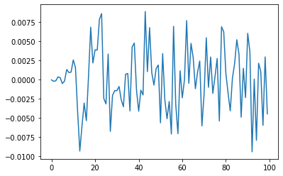
Cross Correlation analysis
:Pre-Frontal and Frontal lobe Cross -Correlation. The x axis is frequency and y axis the correlation value.

Slide 8
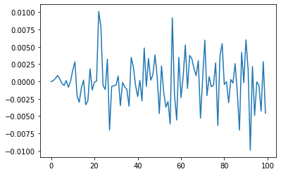
Cross Correlation analysis
Pre-Frontal and Temporal lobe Cross -Correlation. The x axis is frequency and y axis the correlation value.

Slide 9
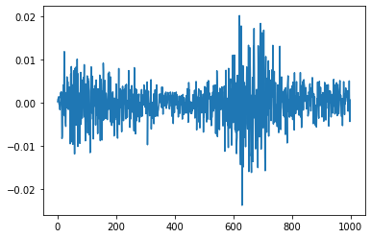
Cross Correlation analysis
Total Cross correlation of the Pre-frontal and left occipital. The x axis is frequency and y axis the correlation value.

Slide 10
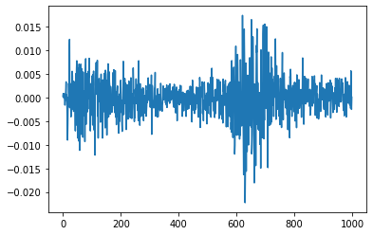
Cross Correlation analysis
Total Cross correlation of the Pre-frontal and right occipital. The x axis is frequency and y axis the correlation value.

Slide 11
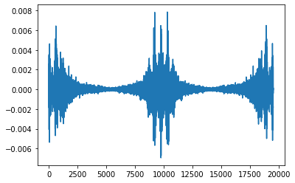
Cross Correlation analysis
differentiation of Total Cross correlation of the Pre-frontal and left occipital with Pre-frontal and right occipital. The x axis is frequency and y axis the correlation value.

Slide 12
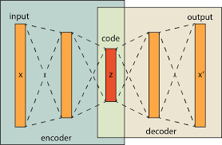
Conclusion and future works
We can see how different areas of the brain communicate in the diagrams above. The cross-correlation of the distinct lobes is difficult to interpret at first look (Figure 2-10). When we look at Figures 11–13, which show the entire cross correlations, we can see that several harmonics have emerged. Of course, we cannot determine how different brain lobes communicate, but the above data may be used to train a convolutional autoencoder (CAE), which is more instructive and informative. Since the CAE may extract a large number of features.

Slide 13
The Final Stage Fuzzy Causal Effect Variational Autoencoder

Slide 14
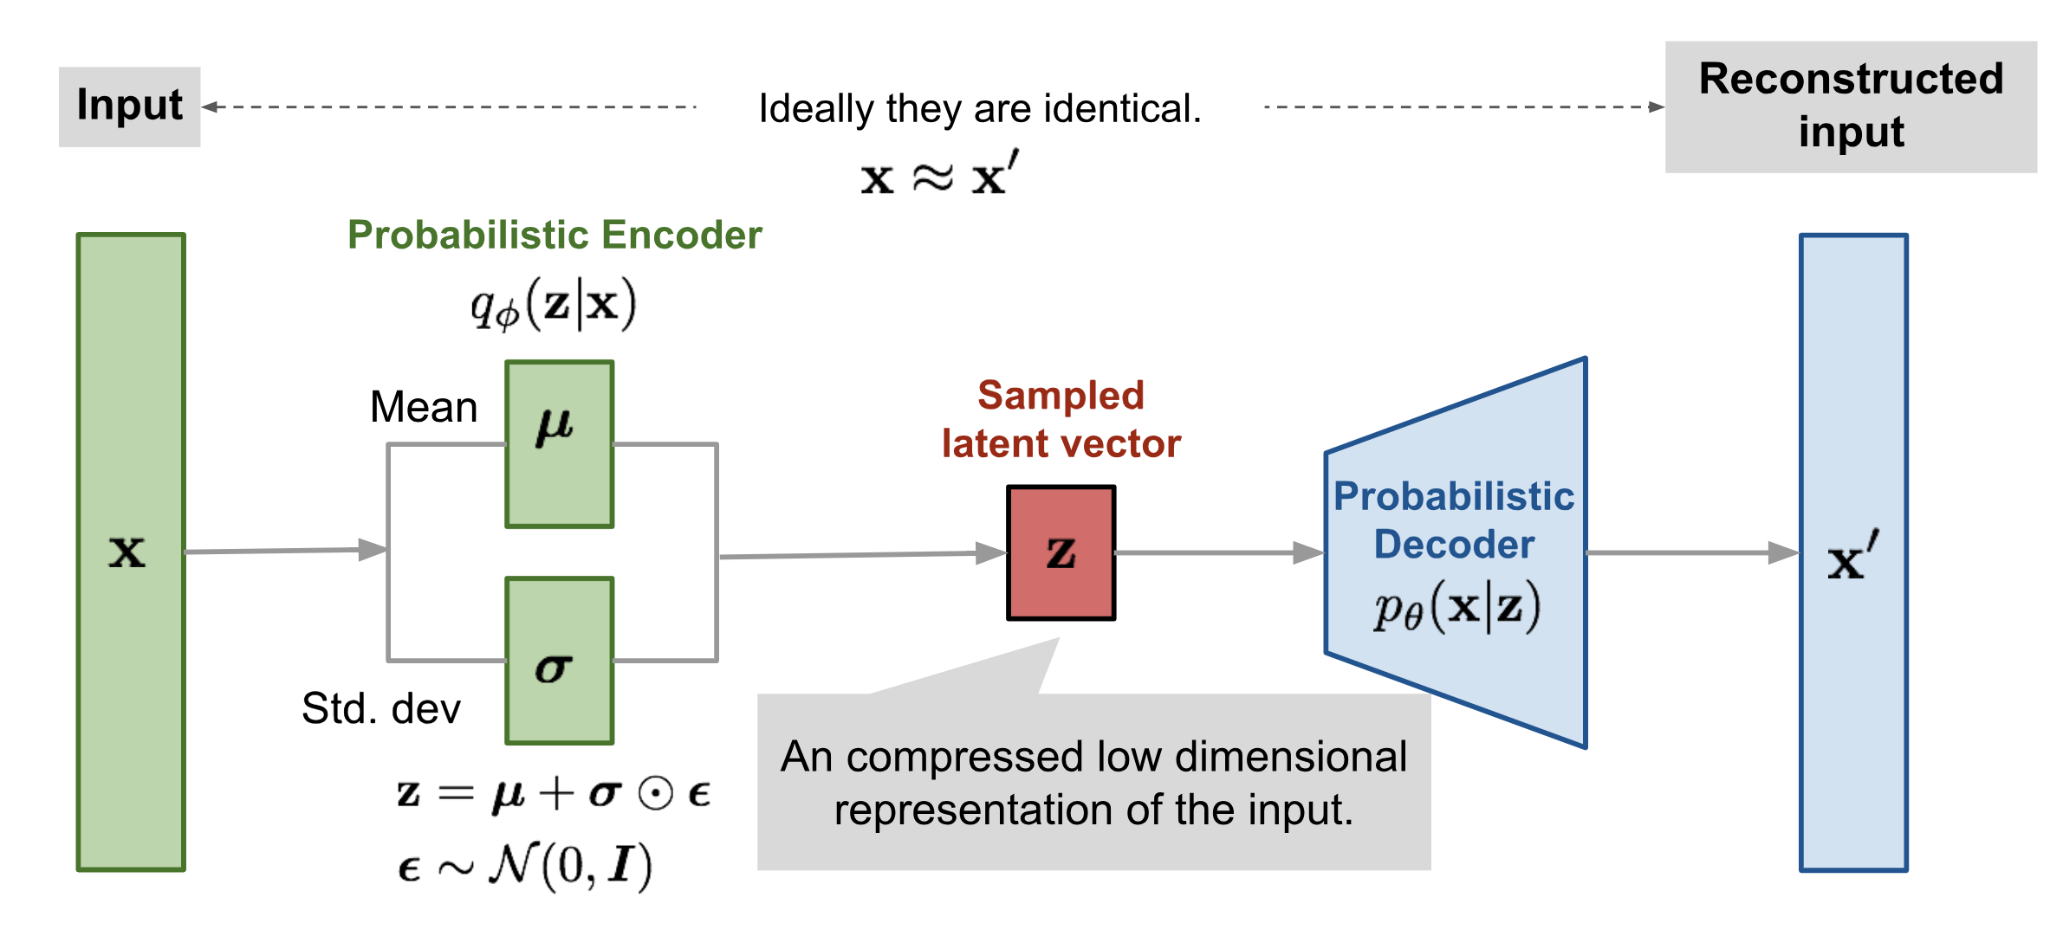
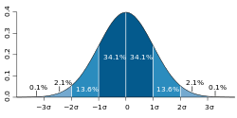
Variational Autoencoder
Variational Autoencoder
Autoencoder
Normal distribution

Slide 15
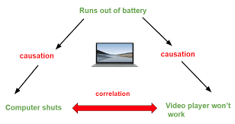
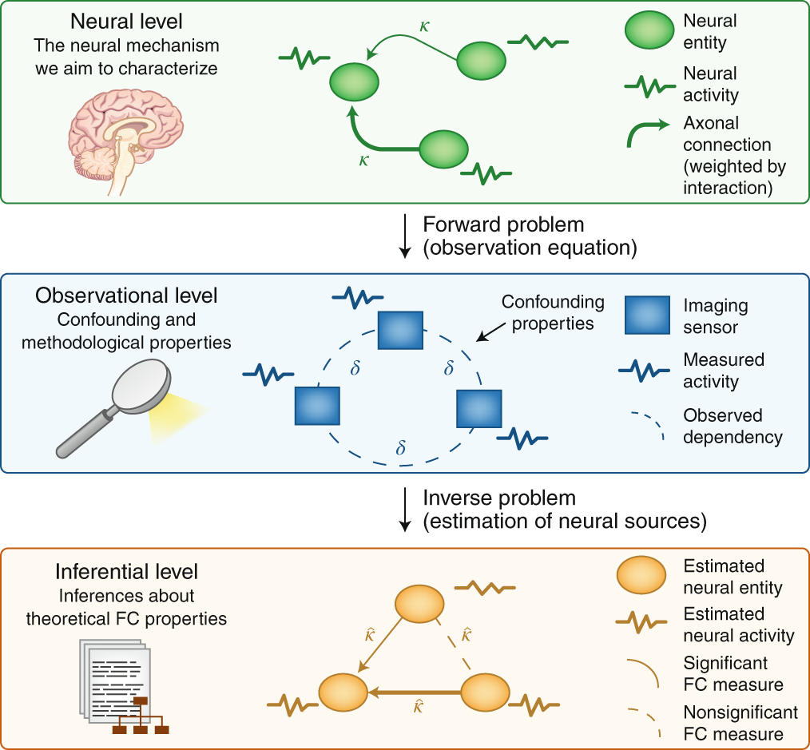
A quick intro to Causality

Slide 16
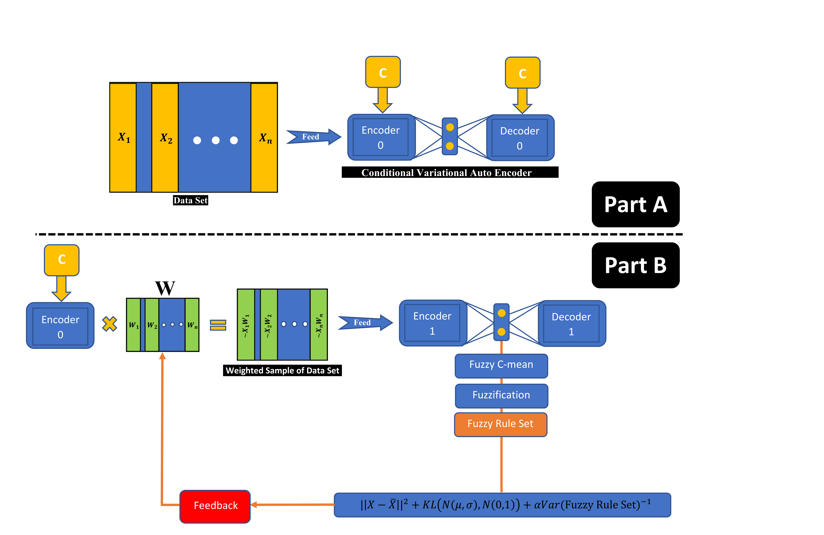
Variational Autoencoder
FCEVAE
Good for correlation extraction
Good for cause extraction

Slide 17
References
1. Wardle, S.G. and C.I. Baker, Recent advances in understanding object recognition in the human brain: deep neural networks, temporal dynamics, and context. F1000Research, 2020. 9.
2. Cichy, R.M. and D. Kaiser, Deep neural networks as scientific models. Trends in cognitive sciences, 2019. 23(4): p. 305-317.
3. Khosla, M., G.H. Ngo, K. Jamison, A. Kuceyeski, and M.R. Sabuncu, Cortical response to naturalistic stimuli is largely predictable with deep neural networks. Science Advances, 2021. 7(22): p. eabe7547.

